Slide 1
Assertions & Coverages
V.SRAVANTHI
DESIGN ENGINEER
CHIPWEAVE TECHNOLOGIES PVT LTD

Slide 2
CONTENTS
Introduction Of Assertions
Why Assertions
Types of Assertions
Coverage
Types of Coverages

Slide 3
Assertion
In VLSI design verification, assertions are used to check design correctness, catch bugs early, and document design intent.
An assertion is a Boolean or temporal expression that must hold true for the design to be considered correct.
If the condition fails, the verification tool reports an assertion failure.
Assertions can be written in SystemVerilog Assertions (SVA), PSL, OVL, or other supported languages

Slide 4
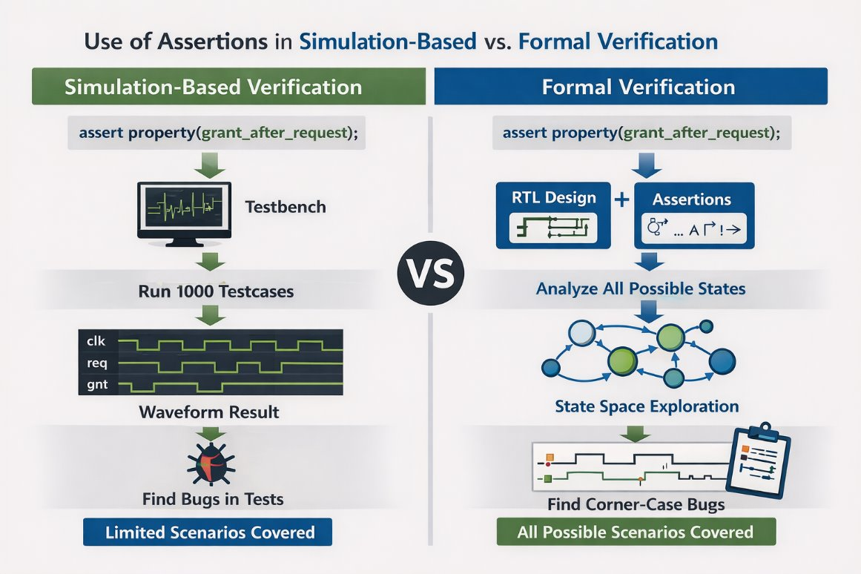
Why Assertions?
Early bug detection — catches issues before full testbench is ready .
Reduced debug time — failures point directly to the violated property.
Documentation — captures design intent in executable form.
Reusable — can be applied from block-level to system-level verification.
Supports both simulation and formal verification.

Slide 5
Assertions(Contd..)
Example:
always @(posedge clk)
begin
assert (reset == 1'b0) else $error("Reset is not de-asserted");
end
This checks that reset is low at every positive clock edge

Slide 6
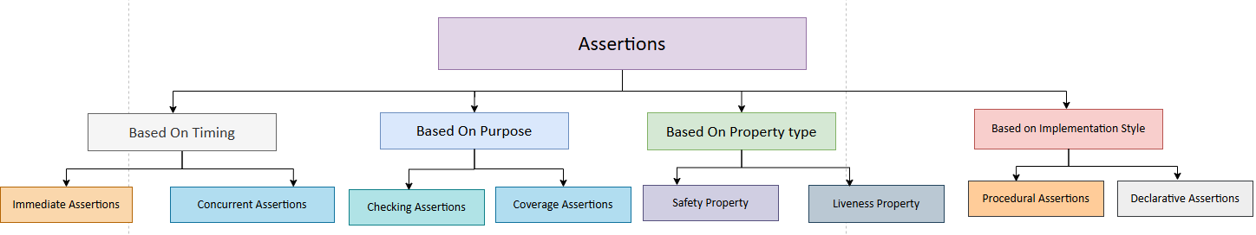
Types Of Assertions
Fig 1.Assertions Classification

Slide 7
Types Of Assertions(Contd..)
1.Immediate Assertions
Purpose: Check a condition instantly (single-cycle).
Syntax: assert (<boolean_expr>) else <action_if_fail>;
Example:
always @(posedge clk)
begin
assert (reset == 0) else $error("Reset is active unexpectedly");
end
Used for combinational checks or parameter validation.

Slide 8
Types Of Assertions(Contd..)
2. Concurrent Assertions
Purpose: Check temporal relationships over multiple cycles.
Syntax: assert property (@(posedge clk) disable iff (reset)
<sequence_or_property>);
Example (Handshake):
property req_ack;
@(posedge clk) disable iff (reset)
req |-> ##[1:3] ack; // ack must follow req within 1–3 cycles
endproperty
assert property (req_ack);
Used for protocol checks and timing constraints.

Slide 9
Types Of Assertions(Contd..)
3. Safety Assertions
Purpose: Ensure something bad never happens.
Example (One-hot encoding):
assert property (@(posedge clk) disable iff (reset)
$onehot0(state))
else $fatal("State machine not one-hot encoded");
Used for illegal state prevention and mutual exclusion.
4. Liveness Assertions
Purpose: Ensure something good eventually happens.
Example (Grant after request):
assert property (@(posedge clk) disable iff (reset)
req |-> ##[1:5] grant)
else $error("Grant not issued within 5 cycles");

Slide 10
Types Of Assertions(Contd..)
5. Coverage Assertions
Purpose: Record that a certain event or sequence occurred.
Syntax:cover property (@(posedge clk) <sequence>);
Example:cover property (@(posedge clk) req ##1 ack);
Use for functional coverage in simulation.
6. Checking Assertion
Purpose: Ensure two signals are never high at the same time.
Example:
assert property (@(posedge clk) disable iff (reset)
!(master1_en && master2_en))
else $error("Mutual exclusion violated");

Slide 11
What is Coverage?
Coverage is a metric used to measure how much of the design and functionality has been tested during simulation.
It helps determine:
whether the RTL is sufficiently verified
whether all scenarios are exercised
whether more testcases are needed

Slide 12
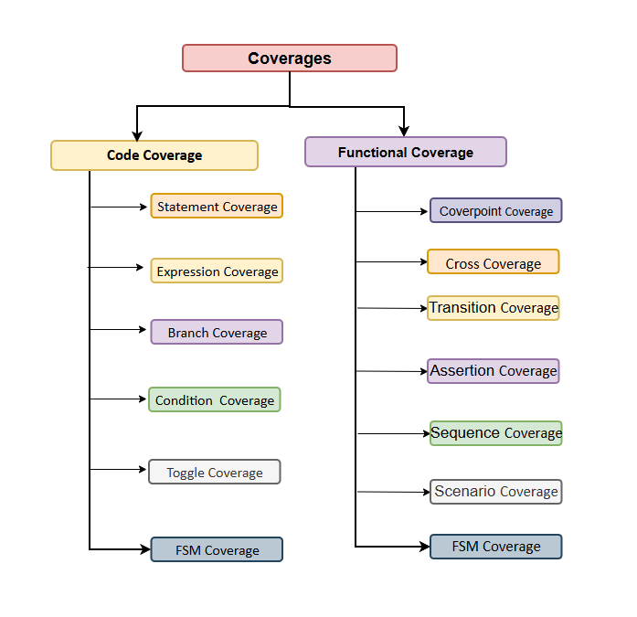
Types Of Coverages
Fig 2.Coverages Classification

Slide 13
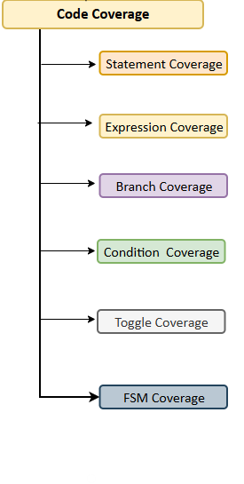
Code Coverage
Code coverage is a verification metric used to measure how much RTL/source code is exercised during simulation.
It helps identify untested or unreachable portions of the design.
Code coverage improves the quality and completeness of verification.
Code Coverage (%)=​ Number of covered items ×100
Total coverable items
Fig 3.Code coverage types

Slide 14


Types Of Code Coverages
1.Statement Coverage
Checks whether every executable statement is executed at least once.
Helps identify unexecuted RTL code.
Example: if (a) y=b;
else y=0;
Both if and else statements must execute.
2. Branch Coverage
Checks whether all decision branches are tested.
Both TRUE and FALSE conditions must occur.
Example: if(req) gnt=1; else gnt=0;
Need req=1 and req=0.
Statement Coverage=Executed Statements​/ Total Statements×100
Example:
Total statements = 200
Executed statements = 180
$$=\frac{180}{200}×100=90\%$$
Branch Coverage=Executed Branches​/ Total Branches×100
Example:
Total branches = 20
Executed branches = 15
$$=\frac{15}{20}×100=75\%$$

Slide 15
Types Of Code Coverages(Contd..)
3.Condition Coverage
Checks each Boolean condition independently.
Every condition must become TRUE and FALSE.
Example: if(a && b) y=1;
a and b should toggle independently.
4. Toggle Coverage
Checks whether signals toggle between 0 and 1.
Detects dead or unused signals.
Signal must transition 0→1 and 1→0.
Example: q <= d;
Toggle Coverage=Observed Toggles​ /Total Possible Toggles ×100
Condition Coverage=Covered Conditions/​ Total Conditions×100

Slide 16
Types Of Code Coverages(Contd..)
5.FSM Coverage
Checks whether all FSM states and transitions are visited.
Ensures complete state-machine verification.
Example: IDLE → BUSY → DONE
Every state and transition must occur.
FSM Coverage=Covered States or Transitions/ Total States or Transitions ​×100
6. Expression Coverage
Checks all outcomes of logical/arithmetic expressions.
Verifies all input combinations.
Example: y = a ^ b;
All XOR input combinations must execute.
Expression Coverage (%)=Covered Expression Outcomes​/ Total Possible Outcomes ×100

Slide 17
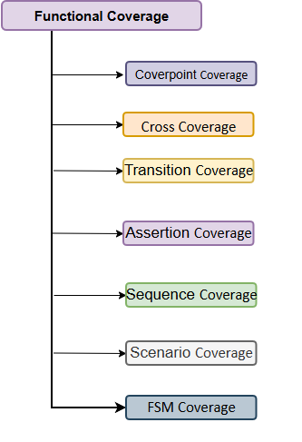
Functional Coverage
Functional coverage is a user-defined verification metric that checks whether all intended design features and scenarios are tested.
It is written using covergroups, coverpoints, bins, and crosses in SystemVerilog.
Unlike code coverage, it focuses on functionality rather than executed RTL lines.
Fig 4.Functional coverage types

Slide 18
Example of Functional Coverage
module tb;
bit [1:0] mode;
covergroup cg;
coverpoint mode {
bins IDLE = {2'b00};
bins READ = {2'b01};
bins WRITE = {2'b10};
bins ERROR = {2'b11}; }
endgroup
cg cov = new();
initial begin
mode = 2'b00; cov.sample();
mode = 2'b01; cov.sample();
mode = 2'b10; cov.sample();
mode = 2'b11; cov.sample();
$display("Coverage = %0.2f %%", cov.get_coverage());
end
endmodule

Slide 19
Types Of Functional Coverages
1. Coverpoint Coverage
Checks whether all values or ranges of a variable are exercised.
Used to monitor specific design parameters or signals.
Example:coverpoint burst_type;
Ensures all burst types are tested.
2. Cross Coverage
Checks combinations of two or more coverpoints.
Useful for verifying interaction between multiple features.
Example: cross burst_type, burst_size;
Ensures all burst type and size combinations occur.

Slide 20
Types Of Functional Coverages(Contd..)
3. Transition Coverage
Checks transitions between values or states.
Mainly used for FSM and protocol verification.
Example: bins trans = (IDLE => BUSY => DONE);
Ensures the required sequence occurs.
4. FSM Coverage
Checks whether all FSM states and transitions are exercised.
Helps ensure complete state-machine verification.
Example: IDLE → READ → WRITE → DONE
All states and transitions must be visited.

Slide 21
Types Of Functional Coverages(Contd..)
5. Assertion Coverage
Checks whether assertions/properties are triggered during simulation.
Used to verify protocol and timing rules.
Example: assert property(req |-> ##1 gnt);
Ensures the assertion is exercised.
6. Scenario Coverage
Checks high-level functional scenarios of the design.
Useful for protocol and system-level verification.
Example: FIFO Full, Empty, Overflow
Ensures all important use cases are tested.

Slide 22
Types Of Functional Coverages(Contd..)
7. Sequence Coverage
Sequence coverage checks whether a specific sequence of events occurs.
It is commonly used in protocol and transaction verification.
Example: req ##1 gnt ##1 done
Ensures the required event sequence happens correctly.

Slide 23


